Slide 1
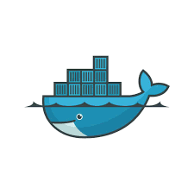
Docker Images And Docker Containerization
By Noor Mustafa Rajpar Bs cs IBA

Slide 2


Slide 3
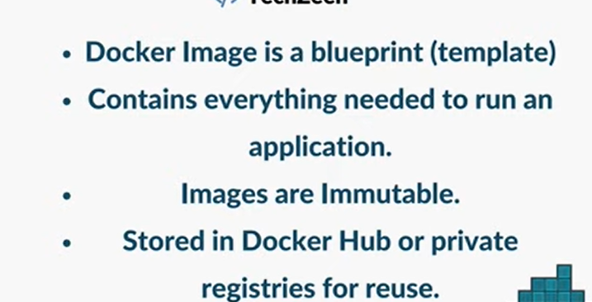

Slide 4
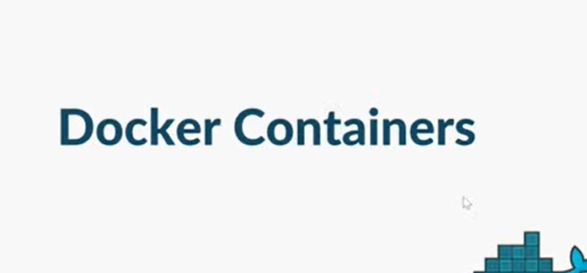

Slide 5
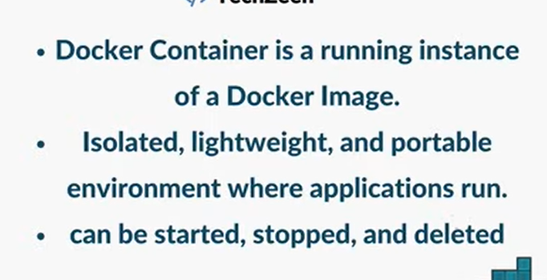

Slide 6


Slide 7
Real Life Example:
A Docker image is like a recipe or blueprint that contains everything needed to run an application, but it is not running by itself. A Docker container is the actual running instance created from that image. For example, a MySQL image is just the setup, while a MySQL container is the working database you can use. In simple words, the image is the plan, and the container is the real working application.

Slide 8
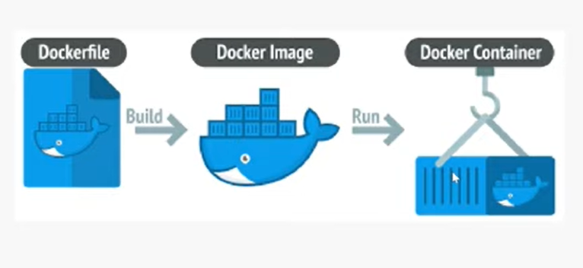
fundamental workflow of Docker.
Dockerfile: It is a text file with instructions (a recipe) that tells Docker how to build your app environment.
Example: A recipe card that says: "Install Python 3.10, copy app.py, and run it."
Docker Image: It is a read-only, frozen package (a cake mix) created from the Dockerfile that contains everything your app needs to run.
Example: A boxed cake mix sitting on a shelf, ready to be used anytime, anywhere.
Docker Container: It is the live, running instance (the actual cake) created from the image that users can interact with.
Example: The baked cake out of the oven, ready to be eaten.

